Slide 1

Welcome!
This course will help you acquire specific skills such as developing, deploying, and running distributed applications using Enterprise JavaBeans 3.0 (EJB 3.0).
Notes:
Instructor notes:
This course will help you acquire specific skills such as developing, deploying, and running
distributed applications using Enterprise JavaBeans 3.0 (EJB 3.0). EJBs are used in real-world
applications such as e-commerce web stores, banking transactions, stock-trading applications,
credit-card processing, and insurance risk analysis applications, to name a few, because of their
compatibility with a wider range of databases and their ability to be reused in multiple applications.
This course is your entry point into learning how to develop EJB-based applications.
With the development of advanced networking technologies, transactions of any nature can be
instantaneously carried out online through the web. As more and more business is conducted
over the Internet, enterprises find that they can achieve more with fewer resources by interacting
with their customers and business partners using networked business-to-business and
business-to-consumer applications. Enterprise JavaBeans provides a platform-independent way
of creating enterprise applications.

Slide 2
EJB3.0
December 2008
Duration of course: 3 days
Notes:
Instructor notes:
Course Description:
Target Student
Java application developers and programers with at least one to two years of experience who are or will be involved in enterprise development.
Course Prerequisites
Before taking this course, students should have advanced knowledge of Java programing. The Element K course that is available to provide this level of knowledge is Java 5: Advanced Programming.

Slide 3
Introductions
Your name
Location – home office
Job role
How long with [industry, practice area, community, etc.]
Something unique about yourself
Notes:
Instructor notes:
Set the tone for the course. Introduce yourself then have the participants introduce themselves:
Your name
Location – home office
Job role
How long with [industry, practice area, community, etc.]
Something unique about yourself

Slide 4

Participant Expectations
What are your expectations?
What made you attend this course?
Notes:
Instructor Notes:
The instructor can begin by asking the class what their expectations are from the course. This should be gathered from the class based on the statistic/problem mentioned in Big Bang/Ice Breaker. This would act as a WIIFM (What’s in it for me) for the target audience. On the next slide, mapping of the class expectations and objectives of the course can be done to enhance the clarity of the audience on the actual goal of the course.
You can ask the following questions:
What are your expectations?
What made you attend this course?

Slide 5

Housekeeping
Breaks
Washrooms
Transportation/parking
No pagers or cell phones
Participation
Parking lot issues
Questions
Notes:
Instructor Notes:
Breaks
Washrooms
Transportation/parking
No pagers or cell phones
Participation
Parking lot issues
Questions

Slide 6

Course Objectives
After completing this course, you will be able to:
  Set up the EJB environment.
  Develop session beans.
  Develop entity beans for accessing and controlling
  the database associated with your application.
  Use EJB Query Language for querying a database
  and retrieving the desired information.
  Develop message-driven beans.
  Process transactions.
  Optimize the performance of a site.
Notes:
Instructor notes:
In this course, you will develop distributed enterprise applications using Enterprise JavaBeans 3.0 and deploy them on a JBoss server.
You will:
Set up the EJB environment.
Develop session beans.
Develop entity beans for accessing and controlling
the database associated with your application.
Use EJB Query Language for querying a database
and retrieving the desired information.
Develop message-driven beans.
Process transactions.
Optimize the performance of a site.

Slide 7
Course Content
Module 1: Preparing To Develop EJB Applications
  Create an Application Plan
    EJB Architecture
    EJB Workflow
    EJB Interaction with a Database
    Features of EJB 3.0
  Determine the Appropriate Bean
    Session Beans
    Entity Beans
    Message-Driven Beans
    Types of Clients
Notes:
Instructor notes:
Module 1: Preparing To Develop EJB Applications
Create an Application Plan
EJB Architecture
EJB Workflow
EJB Interaction with a Database
Features of EJB 3.0
Determine the Appropriate Bean
Session Beans
Entity Beans
Message-Driven Beans
Types of Clients

Slide 8
Course Content
  Configure the JBoss Server for EJBs
    EJB Development Tools
    EJB Storage
    EJB Directory Structure
Module 2: Developing Session Beans
  Determine the Appropriate Session Bean Type
    The States of a Stateless Session Bean
    The States of a Stateful Session Bean
  Create a Remote Interface for a Session Bean
    Remote Business Interface
    The Business Methods
Notes:
Instructor notes:
Configure the JBoss Server for EJBs
EJB Development Tools
EJB Storage
EJB Directory Structure
Module 2: Developing Session Beans
Determine the Appropriate Session Bean Type
The States of a Stateless Session Bean
The States of a Stateful Session Bean
Create a Remote Interface for a Session Bean
Remote Business Interface
The Business Methods

Slide 9
Course Content
  Create a Session Bean Implementation Class
    Session Bean Implementation Class
    Annotation Used
  Create a Session Bean Client
    Commonly Used APIs for a Client Class of a Session Bean
    JNDI
    Calling an EJB Object
    Session Bean Clients
  Deploy a Session Bean Component
    Pack an EJB
    Deployment
    Stub and Skeleton Communication
Notes:
Instructor notes:
Create a Session Bean Implementation Class
Session Bean Implementation Class
Annotation Used
Create a Session Bean Client
Commonly Used APIs for a Client Class of a Session Bean
JNDI
Calling an EJB Object
Session Bean Clients
Deploy a Session Bean Component
Pack an EJB
Deployment
Stub and Skeleton Communication

Slide 10
Course Content
  Create a Stateless Session Bean
    Stateless Session Beans
Module 3: Developing Entity Beans
  Examine Entity Beans
    Ease of Entity Beans
    The States of an Entity Bean
  Create an Entity Bean Class
    Entity Bean Implementation Class
    Annotations Used
    The Entity Management Interface
    Managed vs. Unmanaged Entities
Notes:
Instructor notes:
Create a Stateless Session Bean
Stateless Session Beans
Module 3: Developing Entity Beans
Examine Entity Beans
Ease of Entity Beans
The States of an Entity Bean
Create an Entity Bean Class
Entity Bean Implementation Class
Annotations Used
The Entity Management Interface
Managed vs. Unmanaged Entities

Slide 11
Course Content
  Create a Session Bean to Access an Entity Bean
    The Business Methods
    Bean Implementation Class
    Annotations Used
  Create a Client for an Entity Bean
    Rules and Regulations for Entity Beans Clients
    Commonly Used APIs for a Client Class of an Entity Bean
    JNDI Binding with Annotations
Module 4: Working With EJB Query Language
  Create Basic EJB Queries
    EJB Query Language
    Query API
Notes:
Instructor notes:
Create a Session Bean to Access an Entity Bean
The Business Methods
Bean Implementation Class
Annotations Used
Create a Client for an Entity Bean
Rules and Regulations for Entity Beans Clients
Commonly Used APIs for a Client Class of an Entity Bean
JNDI Binding with Annotations
Module 4: Working With EJB Query Language
Create Basic EJB Queries
EJB Query Language
Query API

Slide 12
Course Content
  Create Parameterized Queries
    Parameterized Queries
Module 5: Examine an JMS Application
  Examine a JMS Application
    Messaging System
    JMS
    Message Types
  Create a Message-Driven Bean Class
    Message-Driven Beans
    Message-Driven Bean Life cycle
    Packages Used
    Annotations Used
Notes:
Instructor notes:
Create Parameterized Queries
Parameterized Queries
Module 5: Examine an JMS Application
Examine a JMS Application
Messaging System
JMS
Message Types
Create a Message-Driven Bean Class
Message-Driven Beans
Message-Driven Bean Life cycle
Packages Used
Annotations Used

Slide 13
Course Content
  Create a Client Class for a Message-Driven Bean
    Message-Driven Bean Clients
  Call an EJB
    ID Autogeneration
  Communicate to an HTML Front-End
Module 6: PROCESSING TRANSACTIONS
  Examine Transactions
    Transactions
    Declarative Transactions
  Define Transaction Attributes
    EJB Transaction Attributes
Notes:
Instructor notes:
Create a Client Class for a Message-Driven Bean
Message-Driven Bean Clients
Call an EJB
ID Autogeneration
Communicate to an HTML Front-End
Module 6: PROCESSING TRANSACTIONS
Examine Transactions
Transactions
Declarative Transactions
Define Transaction Attributes
EJB Transaction Attributes

Slide 14
Course Content
  Set ACID Transaction Properties
    ACID Transactions
  Create a Transactional Stateful Session Bean
    Transactional Stateful Session Beans
    The SessionSynchronization Interface
Module 7: Optimizing Site Performance
  Entrance Bean-Level Performance
    Business Entity Identification
    Network Overheads Minimization
    Local and Remote Interfaces
    Return Entity Data from EJBs
Notes:
Instructor notes:
Set ACID Transaction Properties
ACID Transactions
Create a Transactional Stateful Session Bean
Transactional Stateful Session Beans
The SessionSynchronization Interface
Module 7: Optimizing Site Performance
Entrance Bean-Level Performance
Business Entity Identification
Network Overheads Minimization
Local and Remote Interfaces
Return Entity Data from EJBs

Slide 15
Course Content
  Enhance Database-Level Performance
    Database Access Minimization
    Caching
    Query Combination
    Update Minimization
    Transaction Scope Minimization
Notes:
Instructor notes:
Enhance Database-Level Performance
Database Access Minimization
Caching
Query Combination
Update Minimization
Transaction Scope Minimization

Slide 16
Class Setup
Install the Course Data Files
On the course CD-ROM, run the 085593dd.exe self-extracting file located within. This will install a folder named 085593Data on your C drive. This folder contains all the data files that you will use to complete this course. Solution files are also provided in this folder. These files may help you find a possible solution if you get stuck at any point during the course. If you would like to view the final output or solution of an activity, navigate to the respective lesson\activity\solution folder.
In addition to the specific setup procedures needed for this class to run properly, you should also check the Element K Courseware product support website at http://support.elementkcourseware.com for more information. Any updates about this course will be posted there.
Notes:
Instructor notes:
Install the Course Data Files
On the course CD-ROM, run the 085593dd.exe self-extracting file located within. This will install a folder named 085593Data on your C drive. This folder contains all the datafiles that you will use to complete this course. Solution files are also provided in this folder. These files may help you find a possible solution if you get stuck at any point during the course. If you would like to view the final output or solution of an activity, navigate to the respective lesson\activity\solution folder.
In addition to the specific setup procedures needed for this class to run properly, you should also check the Element K Courseware product support website at http://support.elementkcourseware.com for more information. Any updates about this course will be posted there.

Slide 17
Class Setup
Install Java Software Development Kit v1.5
Download and install the Java Software Development Kit v1.5 (JDK). JDK can be found at: http://java.sun.com/j2se/1.5.0/download.jsp. Follow the installation instructions outlined on Sun’s Java download page.
Set the PATH, CLASSPATH, and JAVA_HOME variables, following Sun’s instructions. The Windows setup instructions can be found at: http://java.sun.com/j2se/1.5.0/install-windows.html.
Notes:
Instructor notes:
Install Java Software Development Kit v1.5
Download and install the Java Software Development Kit v1.5 (JDK). JDK can be found at: http://java.sun.com/j2se/1.5.0/download.jsp. Follow the installation instructions outlined on Sun’s Java download page.
Set the PATH, CLASSPATH, and JAVA_HOME variables, following Sun’s instructions. The Windows setup instructions can be found at: http://java.sun.com/j2se/1.5.0/install-windows.html.

Slide 18
Class Setup
Install JBoss Application Server 4.0.3 SP1
Download and install the JBoss Application Server 4.0.3 SP1(jboss-4.0.3SP1). The jboss-4.0.3SP1 can be found at http://sourceforge.net/project/showfiles.php?group_id=22866&package_id=16942&release_id=365509
Double–click the downloaded jar file, and proceed with the instructions in the wizard to install.
Set the JBOSS_HOME variable to the JBOSS Home directory.
Notes:
Instructor notes:
Install JBoss Application Server 4.0.3 SP1
Download and install the JBoss Application Server 4.0.3 SP1(jboss-4.0.3SP1). The jboss-4.0.3SP1 can be found at http://sourceforge.net/project/showfiles.php?group_id=22866&package_id=16942&release_id=365509
Double–click the downloaded jar file, and proceed with the instructions in the wizard to install.
Set the JBOSS_HOME variable to the JBOSS Home directory.

Slide 19
Class Setup
List of Additional Files
Printed with each activity is a list of files students open to complete that activity. Many activities also require additional files that students do not open, but are needed to support the file(s) students are working with. These supporting files are included with the student data files on the course CD-ROM or data disk. Do not delete these files.
Notes:
Instructor notes:
List of Additional Files
Printed with each activity is a list of files students open to complete that activity. Many activities also require additional files that students do not open, but are needed to support the file(s) students are working with. These supporting files are included with the student data files on the course CD-ROM or data disk. Do not delete these files.

Slide 20
Module 1: Preparing To Develop EJB Applications
Notes:
Instructor notes:
Module 1: Preparing To Develop EJB Applications

Slide 21

Module Objectives
In this lesson, you will set up the EJB environment.
You will:
  Create an application plan for an EJB application.
  Determine the appropriate type of EJB to use.
  Configure and test the JBoss server.
Notes:
Instructor notes:
In this lesson, you will set up the EJB environment.
You will:
Create an application plan for an EJB application.
Determine the appropriate type of EJB to use.
Configure and test the JBoss server.

Slide 22
Introduction to Preparing To Develop EJB Applications
In this module, you will learn to prepare for development of an EJB application
You can ensure smooth development and deployment of your EJB application by appropriately preparing for the tasks involved.
The processes can be simplified by adhering to standard guidelines and best practices.
Creating a plan, documenting the application requirements, identifying the various development options, and finally, testing your application environment, are essential steps that you need to complete to ensure successful development and deployment of your application.
Notes:
Instructor notes:
The introduction provides a definition/value statement that sets the context of the topic for the learner.
Prior to writing any code, you need to establish the environment and plan the application that you will develop. In this lesson, you will learn to prepare for development of an EJB application.
You can ensure smooth development and deployment of your EJB application by appropriately preparing for the tasks involved. The processes can be simplified by adhering to standard guidelines and best practices. Creating a plan, documenting the application requirements, identifying the various development options, and finally, testing your application environment, are essential steps that you need to complete to ensure successful development and deployment of your application.

Slide 23
Topic A: Create An Application Plan
The first step in preparing to develop an EJB application is to analyze the business requirements, identify the components needed, and determine how the components will interact with each other.
An application plan helps to ensure that you reach your final goal of building a working application.
Notes:
Instructor notes:
The first step in preparing to develop an EJB application is to analyze the business requirements,
identify the components needed, and determine how the components will interact with
each other. In this topic, you will create an application plan that includes all of this information.
Building an application without an application plan is like taking a trip without an itinerary.
Without an itinerary, you run the risk of getting lost or never reaching your destination. Similarly,
without an application plan, you run the risk of developing unusable components, which
could lead to massive amounts of rework and a waste of precious development time. An application
plan helps to ensure that you reach your final goal of building a working application.

Slide 24
EJB Architecture
Enterprise JavaBeans (EJBs) are server-side software components that encapsulate the business logic in Java Platform, Enterprise Edition (Java EE).
Advantages of EJB
EJBs provide several advantages to developers and users:
  EJBs are component-based, which means that they can be reused and/or recombined to create new applications.
  EJBs are developed in the Java programming language.
  EJBs run in the platform-independent Java EE environment. You can install your
  EJBs on any vendor’s Java EE-compliant server.
EJBs and JavaBeans
Unlike JavaBeans, EJBs are executed in a Java EE container and provide an interface to the container’s underlying services.
Notes:
Instructor notes:
Enterprise JavaBeans (EJBs) are server-side software components that encapsulate the business
logic in Java Platform, Enterprise Edition (Java EE). The EJB architecture is the overall architecture
for building distributed object-oriented applications by using components developed by
different vendors. EJBs can be classified into three types: session beans, entity beans, and
message-driven beans.
Advantages of EJB
EJBs provide several advantages to developers and users:
• EJBs are component-based, which means that they can be reused and/or recombined
to create new applications.
• EJBs are developed in the Java programming language. This means that you can
quickly assemble EJB applications using a well-known programming model.
• EJBs run in the platform-independent Java EE environment. You can install your
EJBs on any vendor’s Java EE-compliant server.
EJBs and JavaBeans
Java EE EJB and JavaBeans applications are both made up of various components.
However, unlike JavaBeans, EJBs are executed in a Java EE container and provide an
interface to the container’s underlying services.

Slide 25
EJB Workflow
In a Java EE application, the client tier presents data in a web browser or other GUI application.
These clients receive and display dynamic HTML (or other types of output) generated by servlets or Java Server Pages (JSP).
JSPs and servlets may interact with the EJB application components that reside within a secure Java EE application container.
Notes:
Instructor notes:
In a Java EE application, the client tier presents data in a web browser or other GUI application.
These clients receive and display dynamic HTML (or other types of output) generated by
servlets or Java Server Pages (JSP). JSPs and servlets may interact with the EJB application
components that reside within a secure Java EE application container, such as the EJB server,
to process data and perform transactions on a database.

Slide 26
EJB Interaction With A Database
EJBs can interact with any relational database.
In the process of interacting with a database, a client using a web browser or other GUI interface makes a request for some data.
The Java EE container in the server creates a new instance or references an existing instance of an EJB that gets the data from the database and presents it to the client.
One of the significant advantages of using EJBs is that the EJB container can provide many of the low-level services that are needed to make your beans useful.
Low-level services include secure transactions, security, and SQL code generation.
Notes:
Instructor notes:
EJBs can interact with any relational database, since the Java EE specification does not require
vendors to use a specific database tool. In the process of interacting with a database, a client
using a web browser or other GUI interface makes a request for some data. The Java EE container
in the server creates a new instance or references an existing instance of an EJB that
gets the data from the database and presents it to the client.
One of the significant advantages of using EJBs is that the EJB container can provide many of
the low-level services that are needed to make your beans useful. This includes secure transactions,
security, and SQL code generation.

Slide 27
Features of EJB 3.0
Features | Description
Annotations | Annotations are a replacement for deployment descriptors. Annotations can be used to simplify coding. Using annotations reduces the extent of coding since the annotations processor creates the appropriate code at runtime.
Callback methods and Listener classes | The usage of callback methods has been made more efficient with the usage of corresponding callback annotations. Also, callback methods do not need to be unnecessarily implemented, as was the case in the EJB 2.1 specification. In EJB 3.0, a bean listener class can be denoted using the CallbackListener annotation.
Persistent API | The javax.persistence package holds numerous classes and interfaces for managing entities, transactions, and queries.
Notes:
Instructor notes:
EJB 3.0 provides an array of new features that enable you to develop more efficient applications
in a more simplified manner.
Features and their Descriptions
Annotations are a replacement for deployment descriptors - Annotations can be used to simplify coding.
Using annotations reduces the extent of coding since the annotations processor creates the appropriate code at runtime.
Callback methods and Listener classes - The usage of callback methods has been made more efficient with the usage of corresponding callback annotations. Also, callback methods do not need to be unnecessarily implemented, as was the case in the EJB 2.1 specification. In EJB 3.0, a bean listener class can be denoted using the CallbackListener annotation.
Persistent API - The javax.persistence package holds numerous classes and interfaces for managing entities, transactions, and queries.

Slide 28
How To Create An Application Plan
Application plans provide the blueprint for developing Java EE applications. By creating an application plan, you can mitigate the risk of developing unusable components, which could lead to massive amounts of rework and a waste of precious development time.
Guidelines
Follow these guidelines as you create EJB application plans.
An EJB application plan should:
  Identify the discrete modules that comprise the application.
  Identify the type of bean that will be used for each module.
  Chart typical and atypical paths that a user might use through the application.
Notes:
Instructor notes:
Application plans provide the blueprint for developing Java EE applications. By creating an
application plan, you can mitigate the risk of developing unusable components, which could
lead to massive amounts of rework and a waste of precious development time.
Guidelines
Follow these guidelines as you create EJB application plans.
An EJB application plan should:
• Identify the discrete modules that comprise the application.
• Identify the type of bean that will be used for each module.
• Chart typical and atypical paths that a user might use through the application.

Slide 29
Example Of An Application Plan
Many websites allow site access only to registered users. Users who register with the site give up some personal information in exchange for access to the site.
An application plan for such a site might define two modules: the User Registration module and the User Authentication module.
Creating the application plan would involve charting a user’s navigation path through both modules and identifying what type of EJB to use in each module.
Notes:
Instructor notes:
Many websites allow site access only to registered users. Users who register with the
site give up some personal information in exchange for access to the site. An application
plan for such a site might define two modules: the User Registration module and
the User Authentication module. Creating the application plan would involve charting a
user’s navigation path through both modules and identifying what type of EJB to use
in each module.

Slide 30
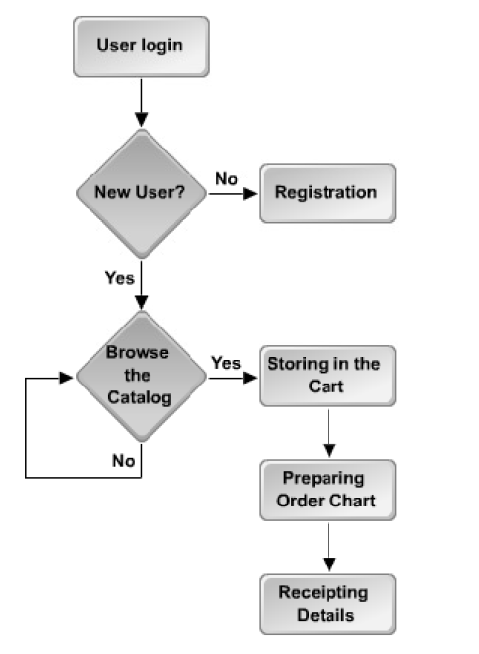
Discovery Activity 1-1
Scenario:
Pearl & Company is a firm that sells books through a network of distributors and retailers.
In keeping with the market trend, they have decided to develop a website to sell their products. They have hired WebSolutions Incorporated, a leading IT solutions provider that specializes in e-commerce applications, to develop their online store.
Notes:
Instructor notes:
Scenario:
Pearl & Company is a firm that sells books through a network of distributors and retailers.
In keeping with the market trend, they have decided to develop a website to sell their products.
They have hired WebSolutions Incorporated, a leading IT solutions provider that specializes in
e-commerce applications, to develop their online store.
You are on the project’s development team and, in conjunction with a representative from
Pearl & Company, you have created the flowchart detailing a typical path that a user might
take through your application.
You have been asked to present your team’s application plan. You should provide the details
regarding your planned application, including a list of the modules, a list of the modules that
require database interaction, a list of fields that will be stored in the database, and a list of
fields that will be used to enable user authentication.

Slide 31
Discovery Activity 1-1
Scenario:
You are on the project’s development team and, in conjunction with a representative from Pearl & Company, you have created the flowchart detailing a typical path that a user might take through your application.
You have been asked to present your team’s application plan. You should provide the details regarding your planned application, including a list of the modules, a list of the modules that require database interaction, a list of fields that will be stored in the database, and a list of fields that will be used to enable user authentication.
Notes:
Instructor notes:
Scenario:
Pearl & Company is a firm that sells books through a network of distributors and retailers.
In keeping with the market trend, they have decided to develop a website to sell their products.
They have hired WebSolutions Incorporated, a leading IT solutions provider that specializes in
e-commerce applications, to develop their online store.
You are on the project’s development team and, in conjunction with a representative from
Pearl & Company, you have created the flowchart detailing a typical path that a user might
take through your application.
You have been asked to present your team’s application plan. You should provide the details
regarding your planned application, including a list of the modules, a list of the modules that
require database interaction, a list of fields that will be stored in the database, and a list of
fields that will be used to enable user authentication.

Slide 32
Discovery Activity 1-1
Creating An Action Plan
1. Make a list of the modules that will be included in your application. | Answers may vary, but should include User Registration and Authentication module, Online Catalog module, Shopping Cart module, Order Generation module, and Invoicing module.
2. List the modules that require database interaction. | The modules that require database interaction are User Registration and Authentication module, Online Catalog module, Order Generation module, and Receipting module.
Notes:
Instructor notes:
1. Make a list of the modules that will be included in your application.
Answers may vary, but should include User Registration and Authentication module,
Online Catalog module, Shopping Cart module, Order Generation module, and Invoicing
module.
2. List the modules that require database interaction.
The modules that require database interaction are User Registration and Authentication
module, Online Catalog module, Order Generation module, and Receipting module.
3. What fields do you need to validate in the User Authentication module?
Answers may vary, but will include user name and password.
4. Consider the User Registration module. List the fields that should be made available to
the user.
The module should store the details of the users, such as user name, password, name,
address, zip code, state, country, phone, and email address.

Slide 33
Discovery Activity 1-1
Creating An Action Plan
3. What fields do you need to validate in the User Authentication module? | Answers may vary, but will include user name and password.
4. Consider the User Registration module. List the fields that should be made available to the user. | The module should store the details of the users, such as user name, password, name, address, zip code, state, country, phone, and email address.
Notes:
Instructor notes:
1. Make a list of the modules that will be included in your application.
Answers may vary, but should include User Registration and Authentication module,
Online Catalog module, Shopping Cart module, Order Generation module, and Invoicing
module.
2. List the modules that require database interaction.
The modules that require database interaction are User Registration and Authentication
module, Online Catalog module, Order Generation module, and Receipting module.
3. What fields do you need to validate in the User Authentication module?
Answers may vary, but will include user name and password.
4. Consider the User Registration module. List the fields that should be made available to
the user.
The module should store the details of the users, such as user name, password, name,
address, zip code, state, country, phone, and email address.

Slide 34
Topic B: Determine The Appropriate Plan
You have created an application plan for an e-commerce website. The next step in development preparation of the EJB application is to determine the type of beans required
Having a successful EJB application as your goal, you need to identify the bean type that will achieve your application’s functionality.
Unless you use the right bean type, you’ll develop beans that don’t achieve project requirements.
Notes:
Instructor notes:
You have created an application plan for an e-commerce website. The next step in development
preparation of the EJB application is to determine the type of beans required to fulfill the
functionality of the application. In this topic, you will follow standard guidelines for determining
the appropriate beans to use.
Before you set off on a road trip, you probably identify the roads that you plan to take. Without
this knowledge, you might take roads that don’t lead to your destination. Similarly, when a
successful EJB application is your goal, you need to identify the bean type that will achieve
your application’s functionality. Unless you use the right bean type, you’ll develop beans that
don’t achieve project requirements.

Slide 35
Session Beans (1/2)
Definition
A session bean is an EJB that implements the SessionBean interface and represents the state of a single client within a server.
Session beans do not save data in a database and are often associated with a client session.
Session beans are associated with a single client and can persist across multiple method invocations.
Clients access session bean methods through interfaces that declare the bean’s methods.
There are two types of session beans: stateful session beans and stateless session beans.
Notes:
Instructor notes:
Definition:
A session bean is an EJB that implements the SessionBean interface and represents
the state of a single client within a server. Session beans do not save data in a database
and are often associated with a client session. Session beans are associated with a
single client and can persist across multiple method invocations. Clients access session
bean methods through interfaces that declare the bean’s methods. There are two types
of session beans: stateful session beans and stateless session beans.

Slide 36
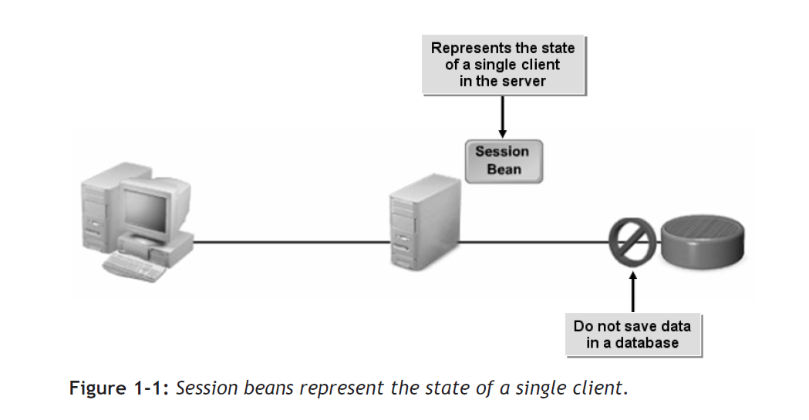
Session Beans (2/2)
Example: You are in charge of creating an online shopping application. You might choose to use session beans for the Shopping Cart module of the application.
Notes:
Instructor notes:
Figure 1-1: Session beans represent the state of a single client.
Example: You are in charge of creating an online shopping application. You might choose to use session beans for the Shopping Cart module of the application.

Slide 37
Entity Beans (1/2)
Definition
An entity bean is an EJB that implements the EntityBean interface.
Entity beans are shared between many clients and represent business objects such as database records.
The main difference between session and entity beans is that an entity bean is persistent.
An entity bean is always mapped to a persistent data store. Clients access entity bean methods through interfaces that declare the bean’s methods.
Notes:
Instructor notes:
Definition:
An entity bean is an EJB that implements the EntityBean interface. Entity beans
are shared between many clients and represent business objects such as database
records. The main difference between session and entity beans is that an entity bean is
persistent. An entity bean is always mapped to a persistent data store. Clients access
entity bean methods through interfaces that declare the bean’s methods.

Slide 38
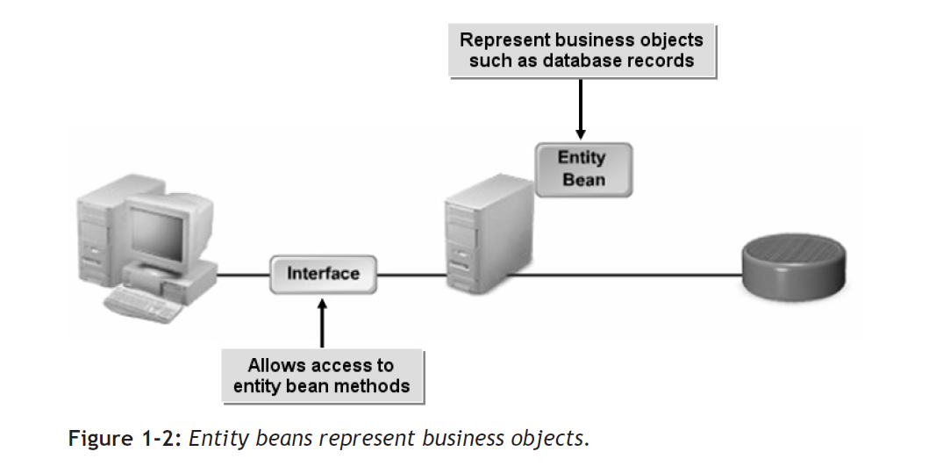
Entity Beans (2/2)
Example: A programming team is developing a web-based banking application. In many cases, they would choose to use entity beans in the application’s Money Transfer module, because entity beans represent a database record and can be shared between clients. Having the ability to share an entity bean among clients is important because different clients (the bank account owner and credit card company, for example) may need concurrent access to the data represented in the entity bean.
Notes:
Instructor notes:
Figure 1-2: Entity beans represent business objects.
Example:
A programming team is developing a web-based banking application. In many cases,
they would choose to use entity beans in the application’s Money Transfer module,
because entity beans represent a database record and can be shared between clients.
Having the ability to share an entity bean among clients is important because different
clients (the bank account owner and credit card company, for example) may need concurrent
access to the data represented in the entity bean.

Slide 39
Message-Driven Beans (1/2)
Definition
A message-driven bean is an EJB that implements the MessageDrivenBean interface and listens for and responds asynchronously to Java Messaging Service (JMS) messages.
Message-driven beans are not accessed through interfaces; they are invoked by JMS messages.
Notes:
Instructor notes:
Definition:
An entity bean is an EJB that implements the EntityBean interface. Entity beans
are shared between many clients and represent business objects such as database
records. The main difference between session and entity beans is that an entity bean is
persistent. An entity bean is always mapped to a persistent data store. Clients access
entity bean methods through interfaces that declare the bean’s methods.

Slide 40
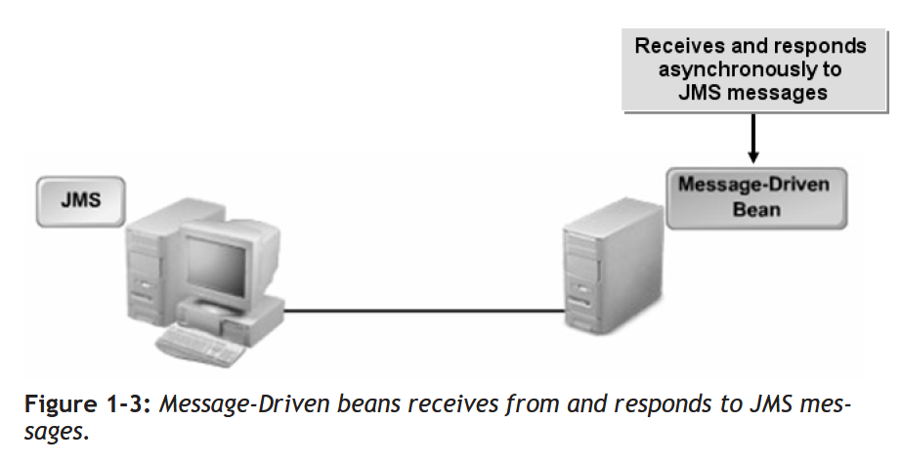
Message-Driven Beans (2/2)
Example: You are developing an online shopping and shipping application. The shipping portion of the application receives information about customer orders and creates shipping requests several times per day. You might choose to use a message-driven bean in the Shipping module to process orders sent from online shoppers.
Notes:
Instructor notes:
Figure 1-3: Message-Driven beans receives from and responds to JMS messages.
Example:
You are developing an online shopping and shipping application. The shipping portion
of the application receives information about customer orders and creates shipping
requests several times per day. You might choose to use a message-driven bean in the
Shipping module to process orders sent from online shoppers.

Slide 41
Types of Clients
The clients of EJB applications can be classified into four types.
Client Type | Description
Local | The client is present in a local environment.
Remote | The client is present at a remote location, such as in another network.
Application | The client accesses the EJB application directly.
Web | The client accesses the EJB application through a web page over the Internet.
Notes:
Instructor notes:
The clients of EJB applications can be classified into four types.
Client Type and Description
Local - The client is present in a local environment.
Remote - The client is present at a remote location, such as in another network.
Application - The client accesses the EJB application directly.
Web - The client accesses the EJB application through a web page over the Internet.

Slide 42
How to Determine the Appropriate Bean (1/2)
By determining which kind of beans will be developed in an EJB application, you can achieve your application’s functionality, and save storage space and development time.
Session beans last, at most, several hours. When a business transaction is completed or the server is shut down, an entity bean’s data is stored in a database.
Notes:
Instructor notes:
By determining which kind of beans will be developed in an EJB application, you can achieve your application’s functionality, and save storage space and development time.
Session beans last, at most, several hours. When a business transaction is completed or the server is shut down, an entity bean’s data is stored in a database.

Slide 43
How to Determine the Appropriate Bean (2/2)
Guidelines
  You need to follow a set of guidelines to determine whether you should use session, entity, or message-driven beans in your application.
  Use a session bean when:
    You need a representation of a business entity or process to which only one client needs access.
    You don’t need permanent storage for the object.
  Use an entity bean when you need:
    A representation of a business entity—not a business process.
    A representation of a business entity that many clients may want to access.
    A permanent representation of the object.
  Use a message-driven bean when you need:
    A bean that can respond to messages asynchronously.
Notes:
Instructor notes:
Guidelines
You need to follow a set of guidelines to determine whether you should use session,
entity, or message-driven beans in your application.
Use a session bean when:
You need a representation of a business entity or process to which only one client needs access.
You don’t need permanent storage for the object.
Use an entity bean when you need:
A representation of a business entity—not a business process.
A representation of a business entity that many clients may want to access.
A permanent representation of the object.
Use a message-driven bean when you need:
A bean that can respond to messages asynchronously.

Slide 44
Example: Choosing an Entity Bean
Example: Choosing an Entity Bean
Consider a banking application developed with EJBs. Among many other features, the application enables customers to log in and move money between accounts.
The application also enables the billing department to access the customer account to send a monthly bill to the customer.
Because several clients may need simultaneous access to customer account details and because account details need to be stored in permanent storage, an entity bean is used for the module that provides access to a customer’s account details.
Notes:
Instructor notes:
Example: Choosing an Entity Bean
Consider a banking application developed with EJBs. Among many other features, the
application enables customers to log in and move money between accounts. The application
also enables the billing department to access the customer account to send a
monthly bill to the customer. Because several clients may need simultaneous access to
customer account details and because account details need to be stored in permanent
storage, an entity bean is used for the module that provides access to a customer’s
account details.

Slide 45
Discovery Activity 1-2
Scenario:
You have created an application plan that meets your client’s requirements. The five modules you identified form the crux of the application plan.
  User Registration and Authentication: Stores the profiles of new users and validates existing users. The details of the users include name, password, and email address. This module provides a unique login ID and password for each user. This process requires extensive data storage and retrieval.
  Online Catalog: Enables users to browse the list of all products. The product details include product code, product name, description, discount, and price. The administrator will add product details to the catalog, while the users can only browse the catalog. This process requires extensive data storage and retrieval.
  Shopping Cart: Stores the books selected by users. As the users shop, the cart keeps track of their selected items. This module also calculates the total amount of the products selected by the users.
Notes:
Instructor notes:
Scenario:
You have created an application plan that meets your client’s requirements. The five modules you identified form the crux of the application plan.
User Registration and Authentication: Stores the profiles of new users and validates existing users. The details of the users include name, password, and email address. This module provides a unique login ID and password for each user. This process requires extensive data storage and retrieval.
Online Catalog: Enables users to browse the list of all products. The product details include product code, product name, description, discount, and price. The administrator will add product details to the catalog, while the users can only browse the catalog. This process requires extensive data storage and retrieval.
Shopping Cart: Stores the books selected by users. As the users shop, the cart keeps track of their selected items. This module also calculates the total amount of the products selected by the users.

Slide 46
Discovery Activity 1-2
Scenario:
  Order Chart: Prepares an order chart for each user based on the items in the shopping cart. In order to prepare the order chart, details about the items such as product ID, product name, and price will be collected from the user as messages.
  Receipting: Validates users’ credit card or account numbers and debits their accounts. If the users do not have sufficient funds in their account, the order will be cancelled.
Your project lead has asked you to determine which type of EJB is appropriate for each of the modules that require them. You should also be prepared to justify your choices.
Notes:
Instructor notes:
Scenario:
Order Chart: Prepares an order chart for each user based on the items in the shopping cart. In order to prepare the order chart, details about the items such as product ID, product name, and price will be collected from the user as messages.
Receipting: Validates users’ credit card or account numbers and debits their accounts. If the users do not have sufficient funds in their account, the order will be cancelled.
Your project lead has asked you to determine which type of EJB is appropriate for each of the modules that require them. You should also be prepared to justify your choices.

Slide 47
Discovery Activity 1-2
Creating An Action Plan
1. What type of bean will you use to develop the User Registration and Authentication module? | This module will store data about users and validate the data when they log in. This process requires extensive data storage and retrieval, so you will have to use an entity bean, because it represents data in the database and can be accessed by multiple clients at a time.
2. What type of bean would you choose to create the Online Catalog functionality? | The Online Catalog displays details about each product, so this process also requires data storage and retrieval. Entity beans would be an ideal solution.
Notes:
Instructor notes:
1. What type of bean will you use to develop the User Registration and Authentication
module?
This module will store data about users and validate the data when they log in. This process
requires extensive data storage and retrieval, so you will have to use an entity bean,
because it represents data in the database and can be accessed by multiple clients at a
time.
2. What type of bean would you choose to create the Online Catalog functionality?
The Online Catalog displays details about each product, so this process also requires data
storage and retrieval. Entity beans would be an ideal solution.
3. What would be the appropriate type of bean for your Shopping Cart functionality?
Since the Shopping Cart application keeps track of the books that a user has selected for
only a certain period of time, a session bean would be the ideal choice. Session beans
perform business tasks or processes and can be accessed by a single client at a time.
4. What would be the ideal solution for developing the Order Chart functionality?
Since the application receives the details about the items that the user has selected as
messages, a message-driven bean will be the ideal solution for incorporating the Order
Chart functionality. Message-driven beans are more reliable and support multiple senders
and receivers.

Slide 48
Discovery Activity 1-2
Creating An Action Plan
3. What would be the appropriate type of bean for your Shopping Cart functionality? | Since the Shopping Cart application keeps track of the books that a user has selected for only a certain period of time, a session bean would be the ideal choice. Session beans perform business tasks or processes and can be accessed by a single client at a time.
4. What would be the ideal solution for developing the Order Chart functionality? | Since the application receives the details about the items that the user has selected as messages, a message-driven bean will be the ideal solution for incorporating the Order Chart functionality. Message-driven beans are more reliable and support multiple senders and receivers.
Notes:
Instructor notes:
1. What type of bean will you use to develop the User Registration and Authentication
module?
This module will store data about users and validate the data when they log in. This process
requires extensive data storage and retrieval, so you will have to use an entity bean,
because it represents data in the database and can be accessed by multiple clients at a
time.
2. What type of bean would you choose to create the Online Catalog functionality?
The Online Catalog displays details about each product, so this process also requires data
storage and retrieval. Entity beans would be an ideal solution.
3. What would be the appropriate type of bean for your Shopping Cart functionality?
Since the Shopping Cart application keeps track of the books that a user has selected for
only a certain period of time, a session bean would be the ideal choice. Session beans
perform business tasks or processes and can be accessed by a single client at a time.
4. What would be the ideal solution for developing the Order Chart functionality?
Since the application receives the details about the items that the user has selected as
messages, a message-driven bean will be the ideal solution for incorporating the Order
Chart functionality. Message-driven beans are more reliable and support multiple senders
and receivers.

Slide 49
Topic C: Configure the JBoss Server for EJBs
You have completed the application plan and identified the types of beans you’ll use for each component of the application.
Preparing to start your EJB application development would not be complete without configuring and testing the JBoss server. In this topic, you will configure and test your JBoss server.
Configuring and testing your server for an EJB application is like preparing your car for a trip.
Just as a broken-down car will prevent you from reaching your chosen destination, an improperly configured server will not allow you to reach your goal of creating and deploying a properly functioning application.
Notes:
Instructor notes:
You have completed the application plan and identified the types of beans you’ll use for each
component of the application. Preparing to start your EJB application development would not
be complete without configuring and testing the JBoss server. In this topic, you will configure
and test your JBoss server.
Configuring and testing your server for an EJB application is like preparing your car for a trip.
Just as a broken-down car will prevent you from reaching your chosen destination, an improperly
configured server will not allow you to reach your goal of creating and deploying a
properly functioning application.

Slide 50
EJB Development Tools
JBoss EJB Software Development Kit (SDK) reference implementation includes a couple of tools for developing and testing EJB applications:
  JBoss server—A widely used Java application server that is freely available for download and distribution.
  Hibernate database—An object/relational persistence and query service.
EJB Deployment
To ensure that Java EE application developers can easily install their EJBs on any Java EE compliant server, Sun has developed a number of technologies that make EJBs portable and self-contained.
These tools enable you to develop and test EJB applications in your environment and seamlessly deploy them on any other supported platform.
Notes:
Instructor notes:
JBoss EJB Software Development Kit (SDK) reference implementation includes a couple of tools for developing and testing EJB applications:
JBoss server—A widely used Java application server that is freely available for download and distribution.
Hibernate database—An object/relational persistence and query service.
EJB Deployment
To ensure that Java EE application developers can easily install their EJBs on any Java EE compliant server, Sun has developed a number of technologies that make EJBs portable and self-contained.
These tools enable you to develop and test EJB applications in your environment and seamlessly deploy them on any other supported platform.

Slide 51
EJB Storage (1/3)
Individual EJBs are stored in compressed Java Archive files (JARs). An EJB JAR contains:
  The enterprise bean class that contains the method implementations for the bean.
  The EJB interfaces that identify how local and remote clients create bean instances and the methods that clients may invoke.
  Any required helper classes.
  And, an XML deployment descriptor and/or additional XML files for persistence.
Notes:
Instructor notes:
Individual EJBs are stored in compressed Java Archive files (JARs). An EJB JAR contains:
The enterprise bean class that contains the method implementations for the bean.
The EJB interfaces that identify how local and remote clients create bean instances and the methods that clients may invoke.
Any required helper classes.
And, an XML deployment descriptor and/or additional XML files for persistence.

Slide 52
EJB Storage (2/3)
Business Interface
For session beans, a client calls methods defined in the bean’s business interface. This interface comprises the client’s view of the bean.
The business interface defines the business methods for the bean.
For example, the business interface for a session bean that handles bank accounts might define a method that credits an account and one that debits an account. The bean class implements the methods defined in the bean’s interfaces.
Deployment Descriptor
The deployment descriptor is an XML file that specifies information about the bean, such as its persistence type and transaction attributes. At the time of deployment, the container reads the bean’s deployment descriptor and provides a standard environment for the bean’s execution.
Notes:
Instructor notes:
Business Interface
For session beans, a client calls methods defined in the bean’s business interface. This
interface comprises the client’s view of the bean. The business interface defines the
business methods for the bean. For example, the business interface for a session bean
that handles bank accounts might define a method that credits an account and one that
debits an account. The bean class implements the methods defined in the bean’s interfaces.
Deployment Descriptor
The deployment descriptor is an XML file that specifies information about the bean,
such as its persistence type and transaction attributes. At the time of deployment, the
container reads the bean’s deployment descriptor and provides a standard environment
for the bean’s execution.

Slide 53
EJB Storage (3/3)
EJB Naming Conventions
As enterprise beans are composed of different components, the following naming convention is used to distinguish them.
Component Name | Naming Convention | Example
Enterprise bean class | <name>Bean | AddCartBean
Remote interface | <name> | AddCart
Local interface | <name>Local | AddCartLocal
EJB JAR display name | <name>JAR | AddCartJAR
Deployable EJB JAR | <name>EJB | AddCartEJB
Notes:
Instructor notes:
As enterprise beans are composed of different components, the following naming convention
is used to distinguish them.
Component Name, Naming Convention and Example
Enterprise bean class - <name>Bean - AddCartBean
Remote interface - <name> - AddCart
Local interface - <name>Local - AddCartLocal
EJB JAR display name - <name>JAR - AddCartJAR
Deployable EJB JAR - <name>EJB - AddCartEJB

Slide 54
EJB Directory Structure
The EJB directory structure consists of the META-INF and the package folders. The METAINF folder holds the XML files.
The MANIFEST.INF is an optional file that can be used to include additional meta-information about the Java Archive (JAR) file.
In addition, the EJB application may contain a Web Archive file (WAR).
If multiple archive files exist, they must, once again, be compiled as an Enterprise Archive file (EAR).
The file is then placed in the deployment folder of the server to be executed.
Notes:
Instructor notes:
The EJB directory structure consists of the META-INF and the package folders. The METAINF
folder holds the XML files. The MANIFEST.INF is an optional file that can be used to
include additional meta-information about the Java Archive (JAR) file.
In addition, the EJB application may contain a Web Archive file (WAR). If multiple archive
files exist, they must, once again, be compiled as an Enterprise Archive file (EAR). The file is
then placed in the deployment folder of the server to be executed.

Slide 55
How to Configure the JBoss Server for EJBs (1/4)
To configure the JBoss server for EJBs:
1. On the desktop, right-click My Computer and choose Properties.
2. In the System Properties dialog box, select the Advanced tab.
3. On the Advanced tab, click Environment Variables.
4. Set the home directory of Java:
  a. In the Environment Variables dialog box, in the User Variables For Administrator section, click New.
  b. In the New User Variable dialog box, in the Variable Name text box, type the desired variable name.
  c. In the Variable Value text box, type the desired variable value and click OK.
  d. In the Environment Variables dialog box, in the System Variables section, click New, and type the desired variable name and variable value.
Notes:
Instructor notes:
Procedure Reference: Configure the JBoss Server for EJBs
To configure the JBoss server for EJBs:
1. On the desktop, right-click My Computer and choose Properties.
2. In the System Properties dialog box, select the Advanced tab.
3. On the Advanced tab, click Environment Variables.
4. Set the home directory of Java:
a. In the Environment Variables dialog box, in the User Variables For Administrator
section, click New.
b. In the New User Variable dialog box, in the Variable Name text box, type the
desired variable name.
c. In the Variable Value text box, type the desired variable value and click OK.
d. In the Environment Variables dialog box, in the System Variables section,
click New, and type the desired variable name and variable value.
5. Set the home directory for the JBoss server:
a. In the Environment Variables dialog box, in the System Variables section,
click New.
b. In the New User Variable dialog box, in the Variable Name text box, type the
desired variable name.
c. In the Variable Value text box, type the desired variable value and click OK.
6. Set the path for JAR files:
a. In the Environment Variables dialog box, in the System Variables section,
click New.
b. In the New User Variable dialog box, in the Variable Name text box, type the
desired variable name.
c. In the Variable Value text box, type the desired variable value and click OK.
7. In the Environment Variables dialog box, click OK.
8. In the System Properties dialog box, click OK.
9. At the command prompt, run the JBoss server.
10. If necessary, press Ctrl+C and type Y to exit.
Procedure Reference: Test the JBoss Server for EJBs
To test the JBoss server for EJBs:
1. Open a command prompt window.
2. Set the class path.
3. Compile the EJB files.
4. Package the EJB application into a JAR file.
5. Copy the JAR file, and paste it in the deploy folder.
6. If necessary, open a new command prompt window.
7. Navigate to the bin folder and run the server.
8. If necessary, press Ctrl+C and type Y to exit.
9. Compile the client Java files.
10. If necessary, set the classpath.
11. Run a client application to test sample EJBs.

Slide 56
How to Configure the JBoss Server for EJBs (2/4)
5. Set the home directory for the JBoss server:
  a. In the Environment Variables dialog box, in the System Variables section,
  click New.
  b. In the New User Variable dialog box, in the Variable Name text box, type the
  desired variable name.
  c. In the Variable Value text box, type the desired variable value and click OK.
Notes:
Instructor notes:
Procedure Reference: Configure the JBoss Server for EJBs
To configure the JBoss server for EJBs:
1. On the desktop, right-click My Computer and choose Properties.
2. In the System Properties dialog box, select the Advanced tab.
3. On the Advanced tab, click Environment Variables.
4. Set the home directory of Java:
a. In the Environment Variables dialog box, in the User Variables For Administrator
section, click New.
b. In the New User Variable dialog box, in the Variable Name text box, type the
desired variable name.
c. In the Variable Value text box, type the desired variable value and click OK.
d. In the Environment Variables dialog box, in the System Variables section,
click New, and type the desired variable name and variable value.
5. Set the home directory for the JBoss server:
a. In the Environment Variables dialog box, in the System Variables section,
click New.
b. In the New User Variable dialog box, in the Variable Name text box, type the
desired variable name.
c. In the Variable Value text box, type the desired variable value and click OK.
6. Set the path for JAR files:
a. In the Environment Variables dialog box, in the System Variables section,
click New.
b. In the New User Variable dialog box, in the Variable Name text box, type the
desired variable name.
c. In the Variable Value text box, type the desired variable value and click OK.
7. In the Environment Variables dialog box, click OK.
8. In the System Properties dialog box, click OK.
9. At the command prompt, run the JBoss server.
10. If necessary, press Ctrl+C and type Y to exit.
Procedure Reference: Test the JBoss Server for EJBs
To test the JBoss server for EJBs:
1. Open a command prompt window.
2. Set the class path.
3. Compile the EJB files.
4. Package the EJB application into a JAR file.
5. Copy the JAR file, and paste it in the deploy folder.
6. If necessary, open a new command prompt window.
7. Navigate to the bin folder and run the server.
8. If necessary, press Ctrl+C and type Y to exit.
9. Compile the client Java files.
10. If necessary, set the classpath.
11. Run a client application to test sample EJBs.

Slide 57
How to Configure the JBoss Server for EJBs (3/4)
6. Set the path for JAR files:
  a. In the Environment Variables dialog box, in the System Variables section,
  click New.
  b. In the New User Variable dialog box, in the Variable Name text box, type the
  desired variable name.
  c. In the Variable Value text box, type the desired variable value and click OK.
7. In the Environment Variables dialog box, click OK.
8. In the System Properties dialog box, click OK.
9. At the command prompt, run the JBoss server.
10. If necessary, press Ctrl+C and type Y to exit.
Notes:
Instructor notes:
Procedure Reference: Configure the JBoss Server for EJBs
To configure the JBoss server for EJBs:
1. On the desktop, right-click My Computer and choose Properties.
2. In the System Properties dialog box, select the Advanced tab.
3. On the Advanced tab, click Environment Variables.
4. Set the home directory of Java:
a. In the Environment Variables dialog box, in the User Variables For Administrator
section, click New.
b. In the New User Variable dialog box, in the Variable Name text box, type the
desired variable name.
c. In the Variable Value text box, type the desired variable value and click OK.
d. In the Environment Variables dialog box, in the System Variables section,
click New, and type the desired variable name and variable value.
5. Set the home directory for the JBoss server:
a. In the Environment Variables dialog box, in the System Variables section,
click New.
b. In the New User Variable dialog box, in the Variable Name text box, type the
desired variable name.
c. In the Variable Value text box, type the desired variable value and click OK.
6. Set the path for JAR files:
a. In the Environment Variables dialog box, in the System Variables section,
click New.
b. In the New User Variable dialog box, in the Variable Name text box, type the
desired variable name.
c. In the Variable Value text box, type the desired variable value and click OK.
7. In the Environment Variables dialog box, click OK.
8. In the System Properties dialog box, click OK.
9. At the command prompt, run the JBoss server.
10. If necessary, press Ctrl+C and type Y to exit.
Procedure Reference: Test the JBoss Server for EJBs
To test the JBoss server for EJBs:
1. Open a command prompt window.
2. Set the class path.
3. Compile the EJB files.
4. Package the EJB application into a JAR file.
5. Copy the JAR file, and paste it in the deploy folder.
6. If necessary, open a new command prompt window.
7. Navigate to the bin folder and run the server.
8. If necessary, press Ctrl+C and type Y to exit.
9. Compile the client Java files.
10. If necessary, set the classpath.
11. Run a client application to test sample EJBs.

Slide 58
How to Configure the JBoss Server for EJBs (4/4)
To test the JBoss server for EJBs:
  1. Open a command prompt window.
  2. Set the class path.
  3. Compile the EJB files.
  4. Package the EJB application into a JAR file.
  5. Copy the JAR file, and paste it in the deploy folder.
  6. If necessary, open a new command prompt window.
  7. Navigate to the bin folder and run the server.
  8. If necessary, press Ctrl+C and type Y to exit.
  9. Compile the client Java files.
  10. If necessary, set the classpath.
  11. Run a client application to test sample EJBs.
Notes:
Instructor notes:
Procedure Reference: Configure the JBoss Server for EJBs
To configure the JBoss server for EJBs:
1. On the desktop, right-click My Computer and choose Properties.
2. In the System Properties dialog box, select the Advanced tab.
3. On the Advanced tab, click Environment Variables.
4. Set the home directory of Java:
a. In the Environment Variables dialog box, in the User Variables For Administrator
section, click New.
b. In the New User Variable dialog box, in the Variable Name text box, type the
desired variable name.
c. In the Variable Value text box, type the desired variable value and click OK.
d. In the Environment Variables dialog box, in the System Variables section,
click New, and type the desired variable name and variable value.
5. Set the home directory for the JBoss server:
a. In the Environment Variables dialog box, in the System Variables section,
click New.
b. In the New User Variable dialog box, in the Variable Name text box, type the
desired variable name.
c. In the Variable Value text box, type the desired variable value and click OK.
6. Set the path for JAR files:
a. In the Environment Variables dialog box, in the System Variables section,
click New.
b. In the New User Variable dialog box, in the Variable Name text box, type the
desired variable name.
c. In the Variable Value text box, type the desired variable value and click OK.
7. In the Environment Variables dialog box, click OK.
8. In the System Properties dialog box, click OK.
9. At the command prompt, run the JBoss server.
10. If necessary, press Ctrl+C and type Y to exit.
Procedure Reference: Test the JBoss Server for EJBs
To test the JBoss server for EJBs:
1. Open a command prompt window.
2. Set the class path.
3. Compile the EJB files.
4. Package the EJB application into a JAR file.
5. Copy the JAR file, and paste it in the deploy folder.
6. If necessary, open a new command prompt window.
7. Navigate to the bin folder and run the server.
8. If necessary, press Ctrl+C and type Y to exit.
9. Compile the client Java files.
10. If necessary, set the classpath.
11. Run a client application to test sample EJBs.

Slide 59
Activity 1-3
Activity Time: 5 minutes
Scenario: You have already installed the JBoss server. As per the client’s requirements, you need to configure the JBoss server for EJB 3.0.
Notes:
Instructor notes:
Activity Time:
5 minutes
Scenario:
You have already installed the JBoss server. As per the client’s requirements, you need to configure
the JBoss server for EJB 3.0.

Slide 60
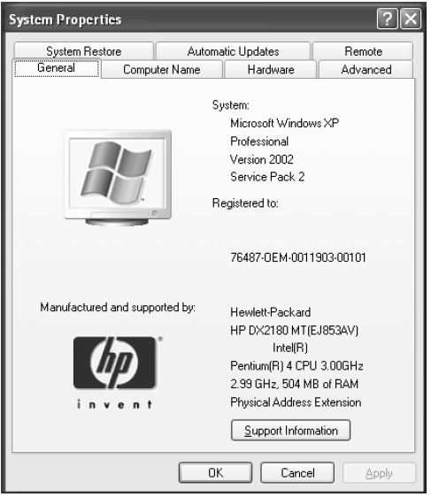
Activity 1-3
What You Do:
Set the home directory of Java.
How You Do It:
On the desktop, right-click the My Computer icon and choose Properties.
In the System Properties dialog box, select the Advanced tab.
Notes:
Instructor notes:
What You Do: 1. Set the home directory of Java.
How You Do It:
a. On the desktop, right-click the My Computer icon and choose Properties.
b. In the System Properties dialog box, select the Advanced tab.

Slide 61
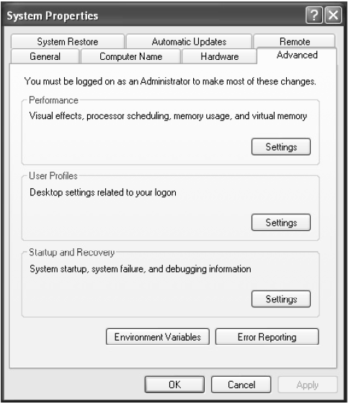
Activity 1-3
What You Do: 1. Set the home directory of Java.
How You Do It:
On the Advanced tab, click Environment
Variables.
Notes:
Instructor notes:
What You Do: 1. Set the home directory of Java.
How You Do It:
c. On the Advanced tab, click Environment
Variables.

Slide 62
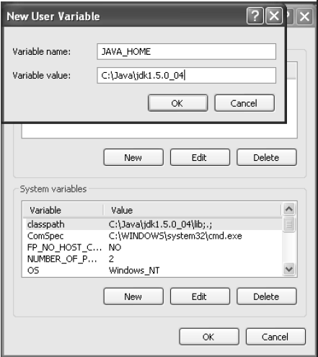
Activity 1-3
What You Do: 1. Set the home directory of Java.
How You Do It:
In the Environment Variables dialog box, in the User Variables For Student section, click New.
In the New User Variable dialog box, in the Variable Name text box, type JAVA_HOME and press Tab to specify the variable name.
In the Variable Value text box, type C:\Java\jdk1.5.0_04 and click OK.
Note: Path and java version may vary
Notes:
Instructor notes:
What You Do: 1. Set the home directory of Java.
How You Do It:
d. In the Environment Variables dialog box,
in the User Variables For Student section,
click New.
e. In the New User Variable dialog box, in
the Variable Name text box, type JAVA_
HOME and press Tab to specify the
variable name.
f. In the Variable Value text box, type
C:\Java\jdk1.5.0_04 and click OK.
Notes:
The version varies
Path varies

Slide 63
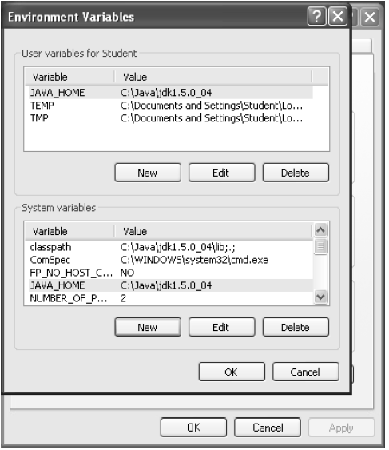
Activity 1-3
What You Do: 1. Set the home directory of Java.
How You Do It:
In the Environment Variables dialog box, in the System Variables section, click New.
Specify the variable name as JAVA_HOME and the variable value as C:\Java\jdk1.5.0_04.
Notes:
Instructor notes:
What You Do: 1. Set the home directory of Java.
How You Do It:
g. In the Environment Variables dialog box,
in the System Variables section, click
New.
h. Specify the variable name as JAVA_
HOME and the variable value as
C:\Java\jdk1.5.0_04.

Slide 64
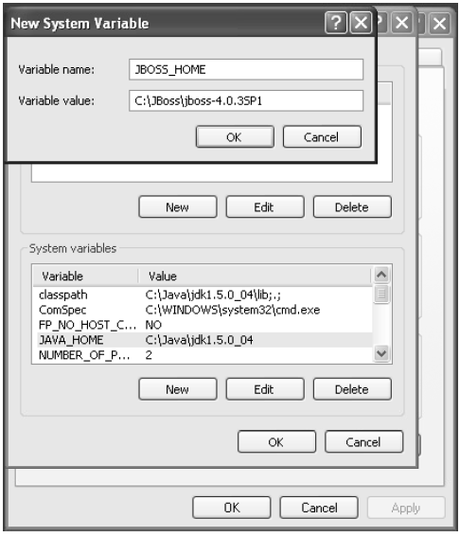
Activity 1-3
What You Do: 2. Set the home directory for the JBoss server.
How You Do It:
In the System Variables section, click New.
In the New System Variable dialog box, in the Variable Name text box, type JBOSS_HOME and press Tab.
In the Variable Value text box, type C:\JBoss\jboss-4.0.3SP1 and click OK.
Notes:
Instructor notes:
What You Do: 2. Set the home directory for the JBoss server.
How You Do It:
a. In the System Variables section, click
New.
b. In the New System Variable dialog box, in
the Variable Name text box, type JBOSS_
HOME and press Tab.
c. In the Variable Value text box, type
C:\JBoss\jboss-4.0.3SP1 and click OK.

Slide 65
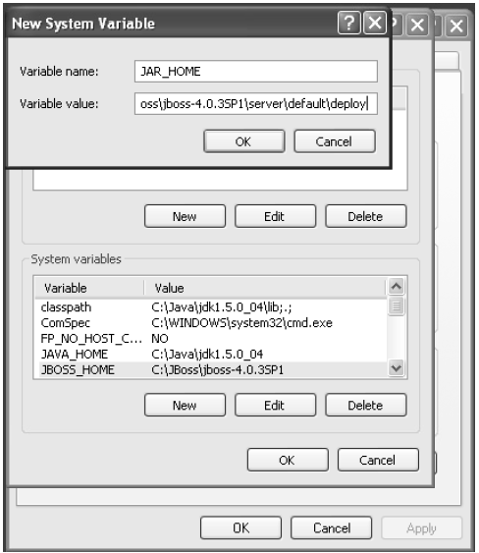
Activity 1-3
What You Do: 3. Set the path for JAR files.
How You Do It:
In the System Variables section, click New.
In the New System Variable dialog box, in the Variable Name text box, type JAR_HOME and press Tab.
In the Variable Value text box, type C:\JBoss\jboss-4.0.3SP1\server\default\deploy and click OK.
Notes:
Instructor notes:
What You Do: 3. Set the path for JAR files.
How You Do It:
a. In the System Variables section, click
New.
b. In the New System Variable dialog box, in
the Variable Name text box, type JAR_
HOME and press Tab.
c. In the Variable Value text box, type
C:\JBoss\jboss-4.0.3SP1\server\
default\deploy and click OK.

Slide 66
Activity 1-3
What You Do: 3. Set the path for JAR files.
How You Do It:
In the Environment Variables dialog box, click OK.
In the System Properties dialog box, click OK.
Notes:
Instructor notes:
What You Do: 3. Set the path for JAR files.
How You Do It:
a. In the System Variables section, click
New.
b. In the New System Variable dialog box, in
the Variable Name text box, type JAR_
HOME and press Tab.
c. In the Variable Value text box, type
C:\JBoss\jboss-4.0.3SP1\server\
default\deploy and click OK.

Slide 67
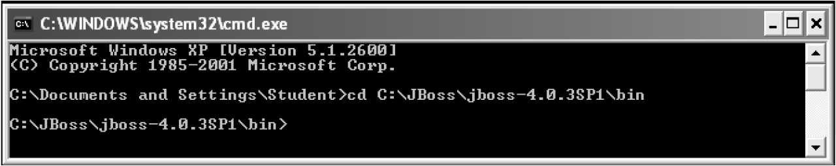
Activity 1-3
What You Do: 4. Run the JBoss server.
How You Do It:
Choose Start→Run.
In the Open text box, type cmd and click OK to open a command prompt window.
At the command prompt, type cd C:\JBoss\jboss-4.0.3SP1\bin and press Enter to navigate to the bin folder.
Notes:
Instructor notes:
What You Do: 4. Run the JBoss server.
How You Do It:
a. Choose Start→Run.
b. In the Open text box, type cmd and click
OK to open a command prompt window.
c. At the command prompt, type
cd C:\JBoss\jboss-4.0.3SP1\bin
and press Enter to navigate to the bin
folder.

Slide 68
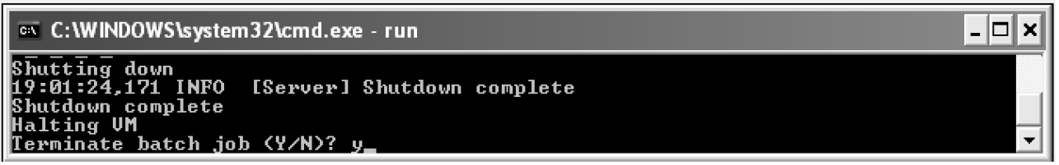
Activity 1-3
What You Do: 4. Run the JBoss server.
How You Do It:
Type run and press Enter.
Press Ctrl+C to stop the server.
At the command prompt, type Y and press Enter to terminate the batch process.
Notes:
Instructor notes:
What You Do: 4. Run the JBoss server.
How You Do It:
d. Type run and press Enter.
e. Press Ctrl+C to stop the server.
f. At the command prompt, type Y
and press Enter to terminate the batch process.

Slide 69
Activity 1-4
Activity Time: 5 minutes
Data Files: TemperatureClient.java
Before You Begin: Open a command prompt window.
Scenario:
To give your client an idea of how EJBs operate, you plan to give him a demonstration with a sample application that you developed for another client.
This means that you need to check your server configuration and run a test application that converts Fahrenheit temperatures to Celsius temperatures. This EJB was a module in a weather application that displayed temperatures around the world.
Notes:
Instructor notes:
Activity Time: 5 minutes
Data Files: TemperatureClient.java (Note: Make sure instructor has secured the file)
Before You Begin: Open a command prompt window.
Scenario:
To give your client an idea of how EJBs operate, you plan to give him a demonstration with a sample application that you developed for another client.
This means that you need to check your server configuration and run a test application that converts Fahrenheit temperatures to Celsius temperatures. This EJB was a module in a weather application that displayed temperatures around the world.

Slide 70
Activity 1-4
What You Do: 1. Set the class path by running the batch files.
How You Do It:
At the command prompt, type cd C:\085593Data\Preparing to Develop EJB Applications\Activity 4\Starter and press Enter.
Type setJBossEnv and press Enter.
What You Do: 2. Package the EJB application into a JAR file.
How You Do It:
At the command prompt, type javac temp\*.java and press Enter.
Notes:
Instructor notes:
What You Do: 1. Set the class path by running the batch files.
How You Do It:
a. At the command prompt, type cd C:\085593Data\Preparing to Develop EJB Applications\Activity 4\Starter and press Enter. (Note: Make sure the files are dumped in this location. Site may vary depending on the instructor).
b. Type setJBossEnv and press Enter.
What You Do: 2. Package the EJB application into a JAR file.
How You Do It:
a. At the command prompt, type javac temp\*.java and press Enter.

Slide 71
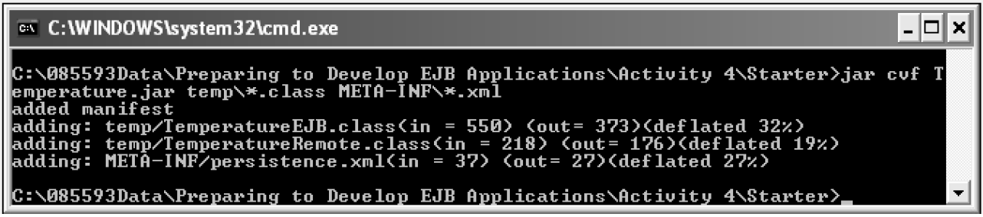
Activity 1-4
What You Do: 2. Package the EJB application into a JAR file.
How You Do It:
Type jar cvf Temperature.jar temp\*.class META-INF\*.xml and press Enter to create the Temperature.jar file.
Notes:
Instructor notes:
What You Do: 2. Package the EJB application into a JAR file.
How You Do It:
b. Type jar cvf Temperature.jar temp\*.class META-INF\*.xml and press Enter to create the Temperature.jar file.

Slide 72
Activity 1-4
What You Do: 3. Deploy the EJB application.
How You Do It:
Copy Temperature.jar from C:\ 085593Data\Preparing to Develop EJB
Applications\Activity 4\Starter and place it in C:\JBoss\jboss-.0.3SP1\server\default\deploy.
Minimize the command prompt window.
Open a new command prompt window.
Notes:
Instructor notes:
What You Do: 3. Deploy the EJB application.
How You Do It:
a. Copy Temperature.jar from C:\ 085593Data\Preparing to Develop EJB
Applications\Activity 4\Starter and place it in C:\JBoss\jboss-.0.3SP1\server\default\deploy.
b. Minimize the command prompt window.
c. Open a new command prompt window.

Slide 73
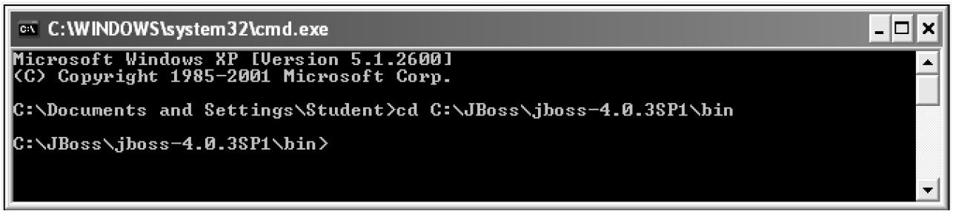
Activity 1-4
What You Do: 3. Deploy the EJB application.
How You Do It:
At the command prompt, type cd C:\JBoss\jboss-4.0.3SP1\bin and press Enter to navigate to the bin folder.
Notes:
Instructor notes:
What You Do: 3. Deploy the EJB application.
How You Do It:
d. At the command prompt, type cd C:\JBoss\jboss-4.0.3SP1\bin and press Enter to navigate to the bin folder.

Slide 74
Activity 1-4
What You Do: 3. Deploy the EJB application.
How You Do It:
Type run and press Enter.
Minimize the command prompt window.
Notes:
Instructor notes:
What You Do: 3. Deploy the EJB application.
How You Do It:
e. Type run and press Enter.
f. Minimize the command prompt window.

Slide 75
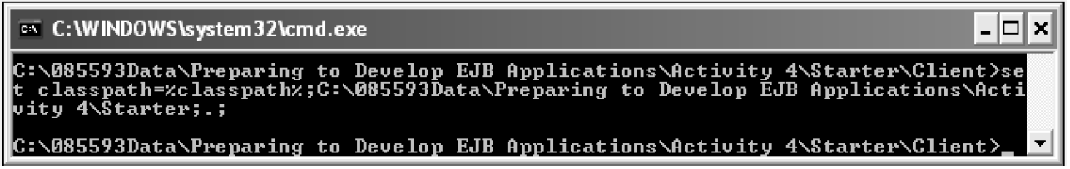
Activity 1-4
What You Do: 4. Compile and run a client application to test the sample EJB.
How You Do It:
Switch to the first command prompt window.
At the command prompt, type cd C:\085593Data\Preparing to Develop EJB Applications\Activity 4\Starter\Client and press Enter.
Type set classpath=%classpath%;C:\085593Data\Preparing to Develop EJB Applications\Activity 4\Starter;.;and press Enter.
Notes:
Instructor notes:
What You Do: 4. Compile and run a client application to test the sample EJB.
How You Do It:
a. Switch to the first command prompt window.
b. At the command prompt, type cd C:\085593Data\Preparing to Develop EJB Applications\Activity 4\Starter\Client and press Enter.
c. Type set classpath=%classpath%;C:\085593Data\Preparing to Develop EJB Applications\Activity 4\Starter;.;and press Enter.

Slide 76
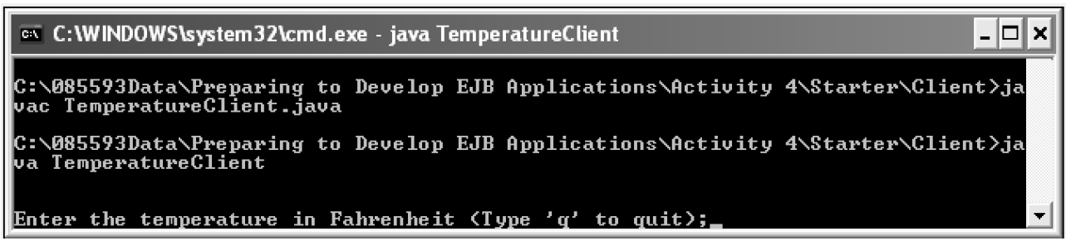
Activity 1-4
What You Do: 4. Compile and run a client application to test the sample EJB.
How You Do It:
At the command prompt, type javac TemperatureClient.java and press Enter.
Type java TemperatureClient and press Enter to execute the TemperatureClient file.
Notes:
Instructor notes:
What You Do: 4. Compile and run a client application to test the sample EJB.
How You Do It:
d. At the command prompt, type javac TemperatureClient.java and press Enter.
e. Type java TemperatureClient and press Enter to execute the TemperatureClient file.

Slide 77
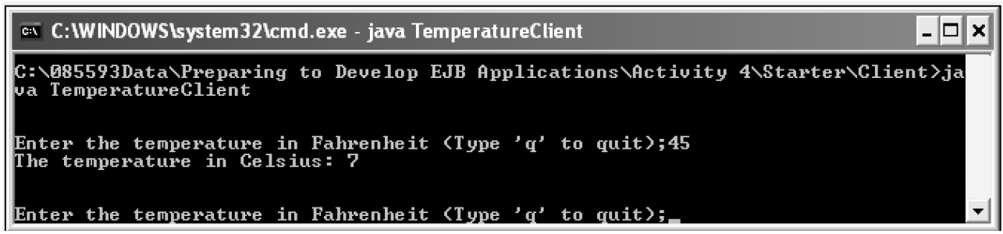
Activity 1-4
What You Do: 4. Compile and run a client application to test the sample EJB.
How You Do It:
Type 45 and press Enter to convert it to Celsius.
Observe that the temperature value is displayed in Celsius.
Notes:
Instructor notes:
What You Do: 4. Compile and run a client application to test the sample EJB.
How You Do It:
f. Type 45 and press Enter to convert it to Celsius.
g. Observe that the temperature value is displayed in Celsius.

Slide 78
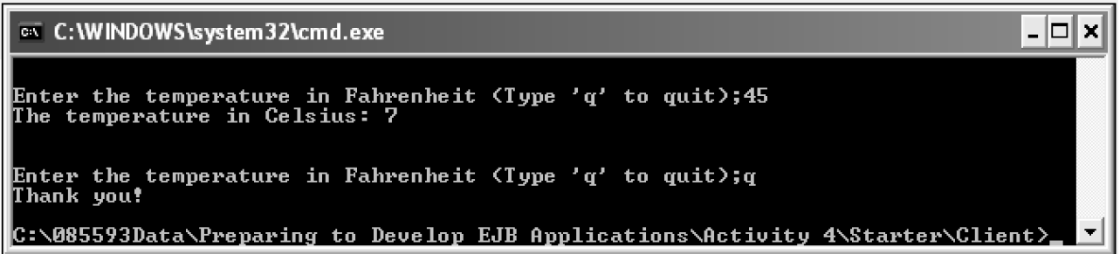
Activity 1-4
What You Do: 4. Compile and run a client application to test the sample EJB.
How You Do It:
h. Type Q and press Enter to quit the conversion.
Notes:
Instructor notes:
What You Do: 4. Compile and run a client application to test the sample EJB.
How You Do It:
f. Type 45 and press Enter to convert it to Celsius.
g. Observe that the temperature value is displayed in Celsius.

Slide 79
Activity 1-4
What You Do: 4. Compile and run a client application to test the sample EJB.
How You Do It:
i. Type exit and press Enter to exit from the command prompt.
j. Switch to the command prompt window.
k. In the command prompt window, press Ctrl+C to stop the server.
l. Type Y and press Enter to terminate the batch process.
m. Type exit and press Enter to exit from the command prompt.
Notes:
Instructor notes:
What You Do: 4. Compile and run a client application to test the sample EJB.
How You Do It:
h. Type Q and press Enter to quit the conversion.

Slide 80
Module Review
In this lesson, you created an application plan and set up the EJB environment in preparation for developing EJB applications. Also, you configured the JBoss server for EJBs. Creating a plan, documenting the application requirements, identifying the various development options, and finally, testing your application environments, are essential steps that you need to complete to ensure successful development and deployment of your application.
1. How would you initiate application development?
2. Why do you think it is important to develop and follow an application plan?
Notes:
Instructor Notes:
In this lesson, you created an application plan and set up the EJB environment in preparation
for developing EJB applications. Also, you configured the JBoss server for EJBs. Creating a
plan, documenting the application requirements, identifying the various development options,
and finally, testing your application environments, are essential steps that you need to complete
to ensure successful development and deployment of your application.
1. How would you initiate application development?
Answers will vary.
2. Why do you think it is important to develop and follow an application plan?
Answers will vary, but may include developing and following an application plan is important
because it creates a reference to ensure that the resulting application has met its
goals, and it identifies what type of EJB component will provide a given functionality of
the application.

Slide 81
Module Summary
Having completed this topic, you should be able to:
  Create an application plan for an EJB application.
  Determine the appropriate type of EJB to use.
  Configure and test the JBoss server.
Notes:
Instructor Notes: This is the summary of the first topic of the first module.
Having completed this topic, you should be able to:
Create an application plan for an EJB application.
Determine the appropriate type of EJB to use.
Configure and test the JBoss server.

Slide 82

Congratulations!
Congratulations for completing this module!
Thanks for your participation!

